Slide 1
Global PSP Project for Indian Embassies and Consulates
Quick Guide – Change Address/Initiate PV Request screen

Slide 2
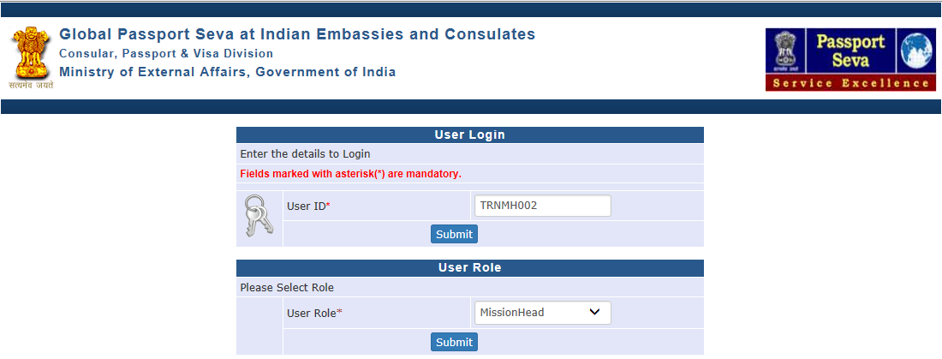
Login Using User ID, Password, and Grid Values
Visit Global PSP Office Portal (https://embassy.passportindia.gov.in)
Enter User ID
Press Submit button
Choose User Role (‘PIA’ and ‘MissionHead’ roles’ users have the authority to use the Change Address/Initiate PV Request screen)
Press Submit button displayed below the User Role

Slide 3
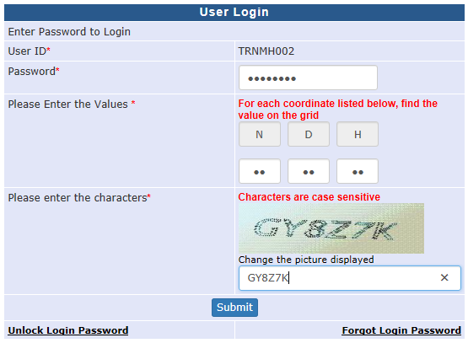
Login Using User ID, Password, and Grid Values (continued..)
Enter Password
Check your User Grid and enter the values for the three alphabets displayed on the screen
Enter the characters displayed in the CAPTCHA image
Press Submit button

Slide 4
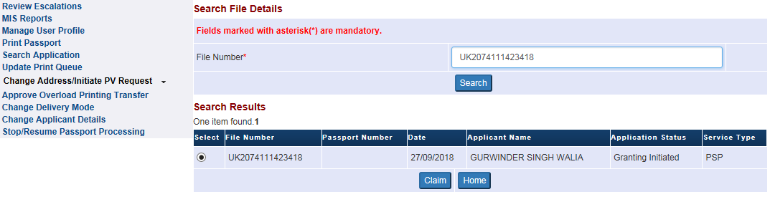
Change Address/Initiate PV Request
Click on the link ‘Change Address/Initiate PV Request’
Enter the File Number inside the Text Box
Click on the Search button

Slide 5
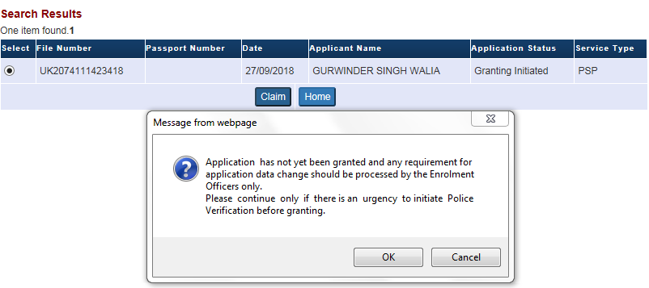
Change Address/Initiate PV Request
Select the fetched application record and press Claim button
System displays alert message that this screen should not be used for application data change if the selected application is not yet granted. Press “OK” to continue with PV Request Initiation (without making any data change) if required, or press “Cancel” to fetch another application)

Slide 6
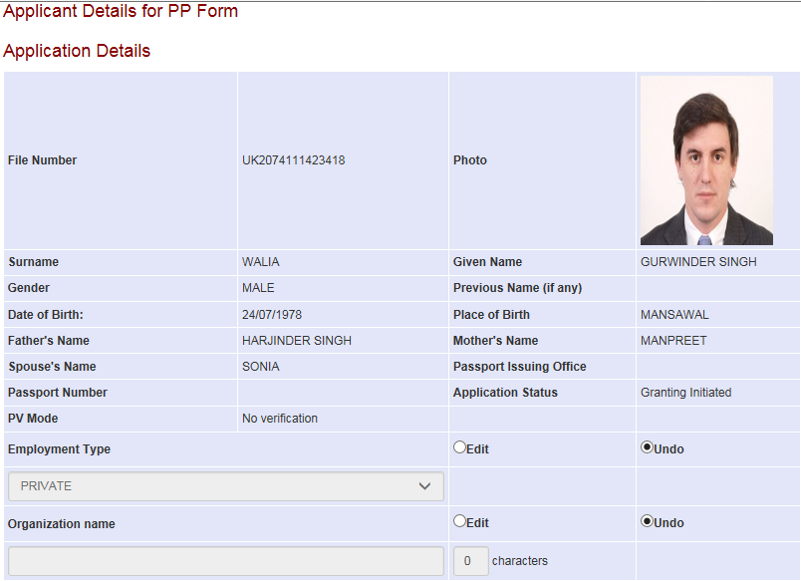
Change Address/Initiate PV Request (continued..)
All applicant details that are part of PP Form/PV Request are displayed on screen (click “Edit” to make changes, “Undo” to reset)

Slide 7
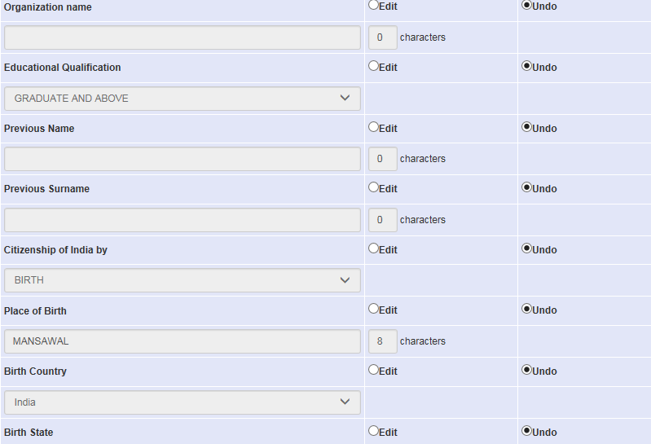
Change Address/Initiate PV Request (continued..)
Select 'Edit' radio button to enable the respective field for data change
Select 'Undo' radio button if original values are to be retained

Slide 8
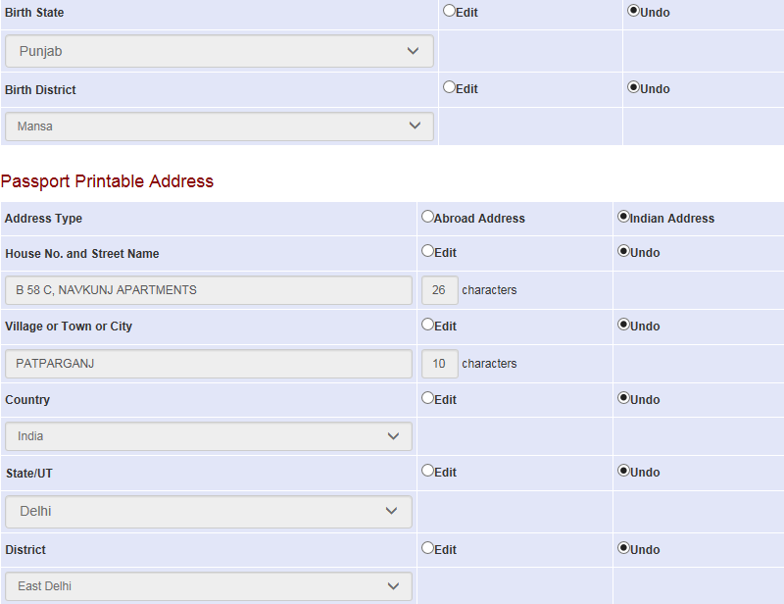
Change Address/Initiate PV Request (continued..)

Slide 9
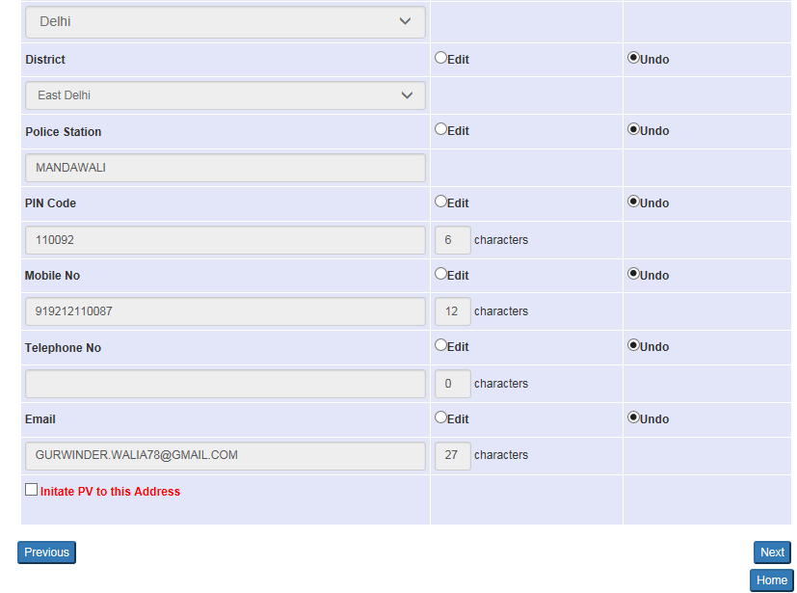
Change Address/Initiate PV Request (continued..)
1. Click Next to continue to the next page

Slide 10
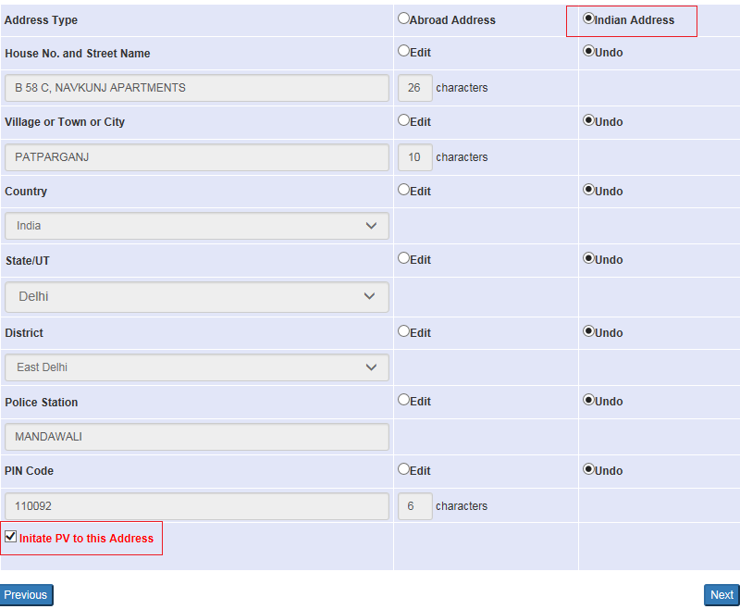
Change Address/Initiate PV Request Link (continued)
Police Station Name, PIN Code and “Initiate PV” check-box will appear for Indian Addresses. Tick this check-box if PV Request is to be initiated for the displayed ‘Passport Printable Address’ or/and ‘Other Address’

Slide 11
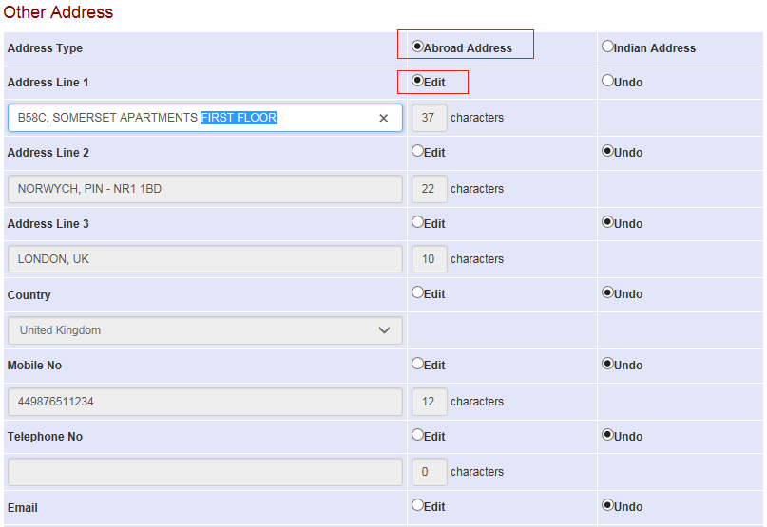
Change Address/Initiate PV Request (continued)
Details can be changed for Indian as well as Abroad addresses. However, PV request can be initiated only for Indian addresses.

Slide 12
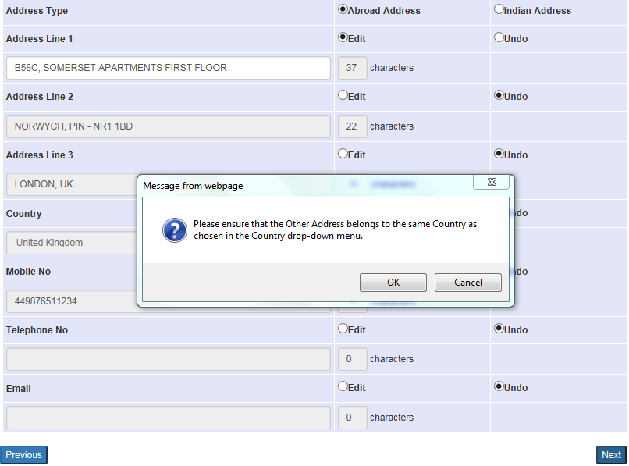
'Change Address/Initiate PV Request' Link (continued)
1. Confirmation Message to validate the country name will be displayed after clicking the Next button if abroad address is updated

Slide 13
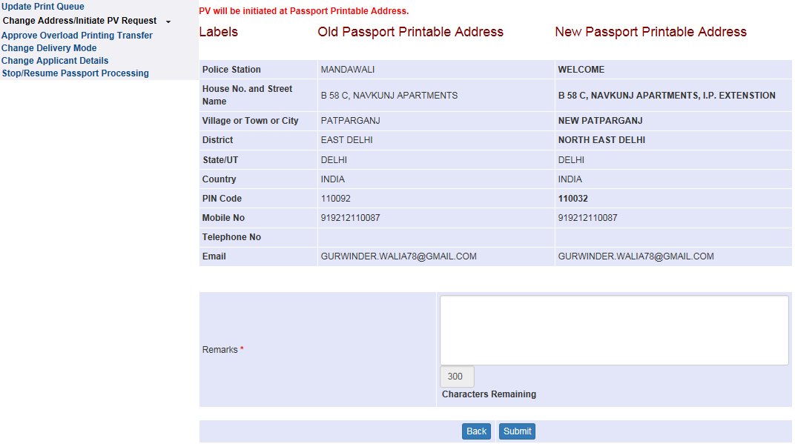
'Change Address/Initiate PV Request' Link (continued)
In the end – a Confirmation Screen displaying 'Changed Details‘ (highlighted in bold) and address(es) where PV Request will be initiated is displayed. Enter Remarks before clicking 'Submit' button to complete the data change/PV Request initiation. Else press 'Back' to edit/undo.

Slide 14
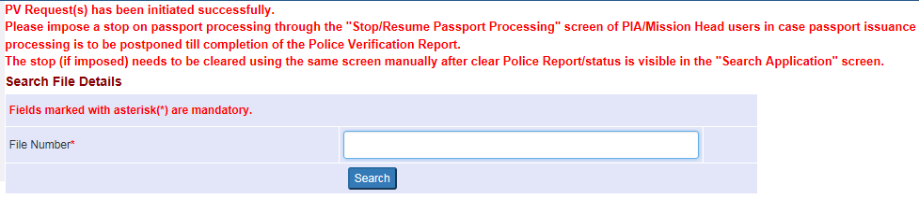
'Change Address/Initiate PV Request' Link (continued)
Confirmation message in case PV is also initiated suggests the user to impose a Stop on Passport Processing using the ‘Stop/Resume Passport Processing’ link of PIA/Mission Head users if passport printing/issuance is to be kept on hold till receipt of Clear PVR.

Slide 15
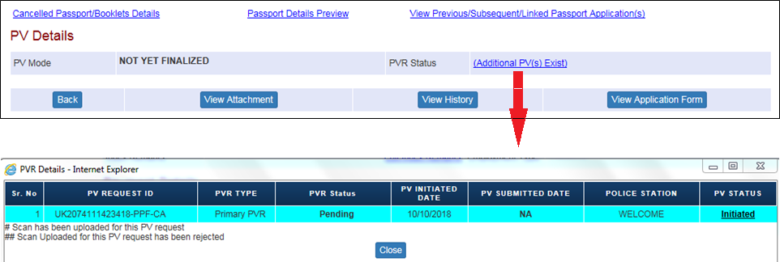
Checking Status of Police Verification Report in Search Application screen
PVR Status can be checked in the Search Application Screen under “PV Details” block
Click on the PVR Status value (displayed as hyperlink) to view details i.e. latest status of processing of the PV Request(s) initiated for the searched application

Slide 16
In case of additional information or clarification, please contact Global PSP Support Team at
Email : global.psp@tcs.com
Phone : +91-0120-672-9595/96
Mobile : +91-730-351-9595
Thank You

